Slide 1
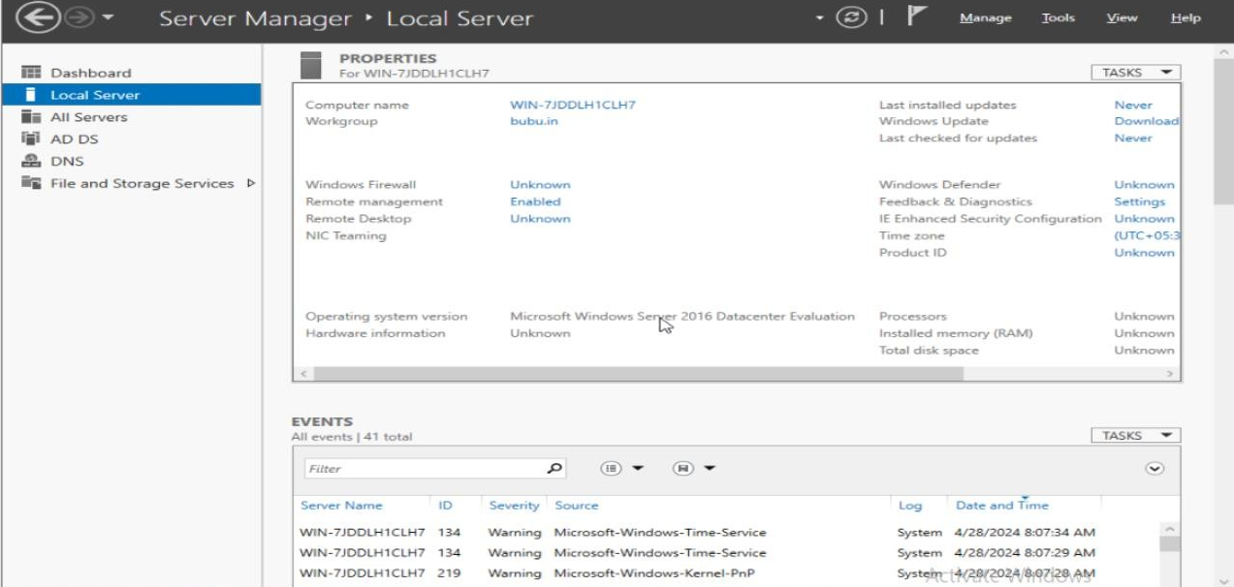
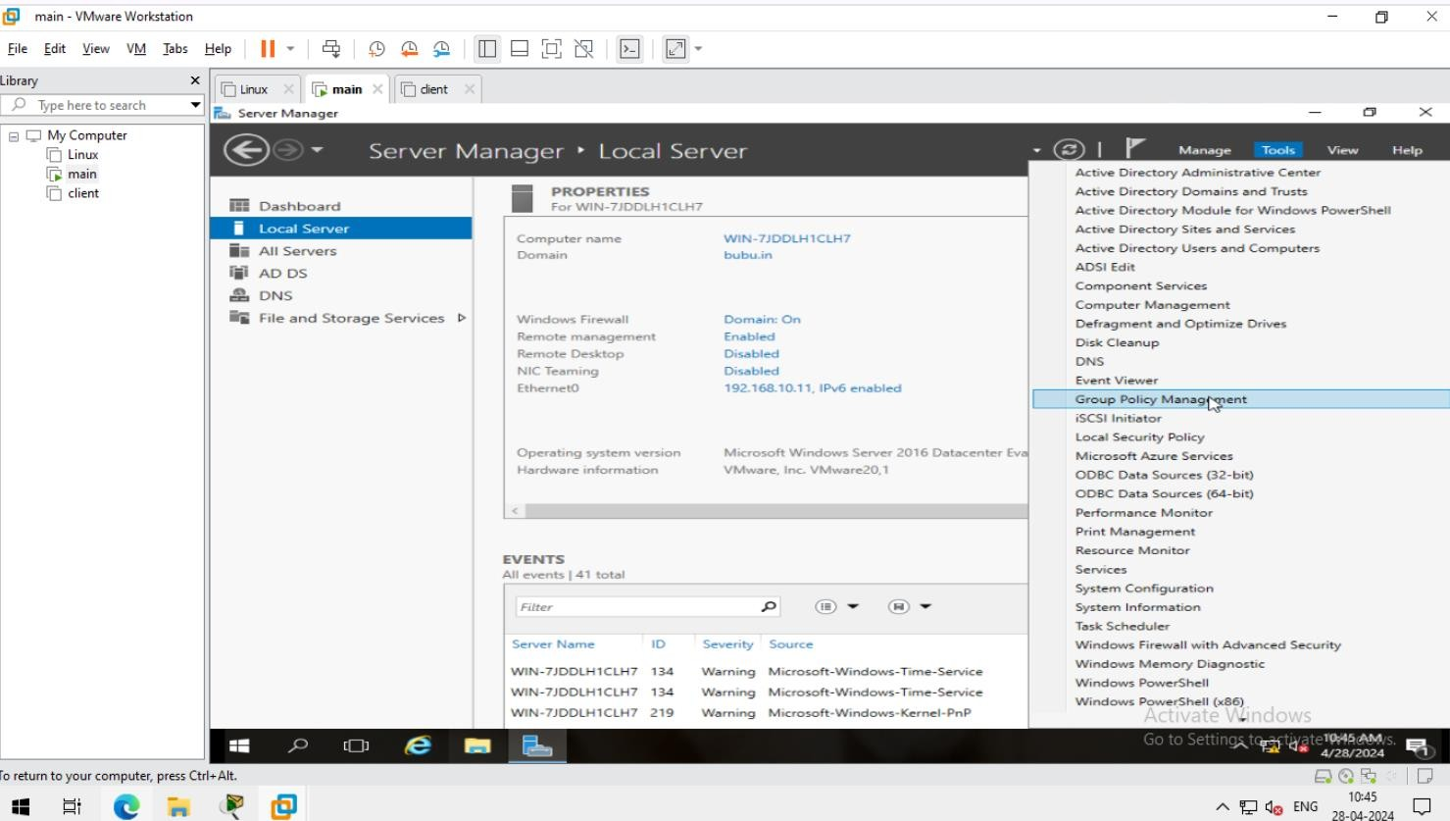
TASK WINDOWS
1. Ensure that you have a windows-based domain environment (with a DC & Member). Create a group policy and apply it on the all the computers that are domain joined. This policy basically applies the same wallpaper in all the computers within the domain.
SERVER MACHINE
1.
2.

Slide 2
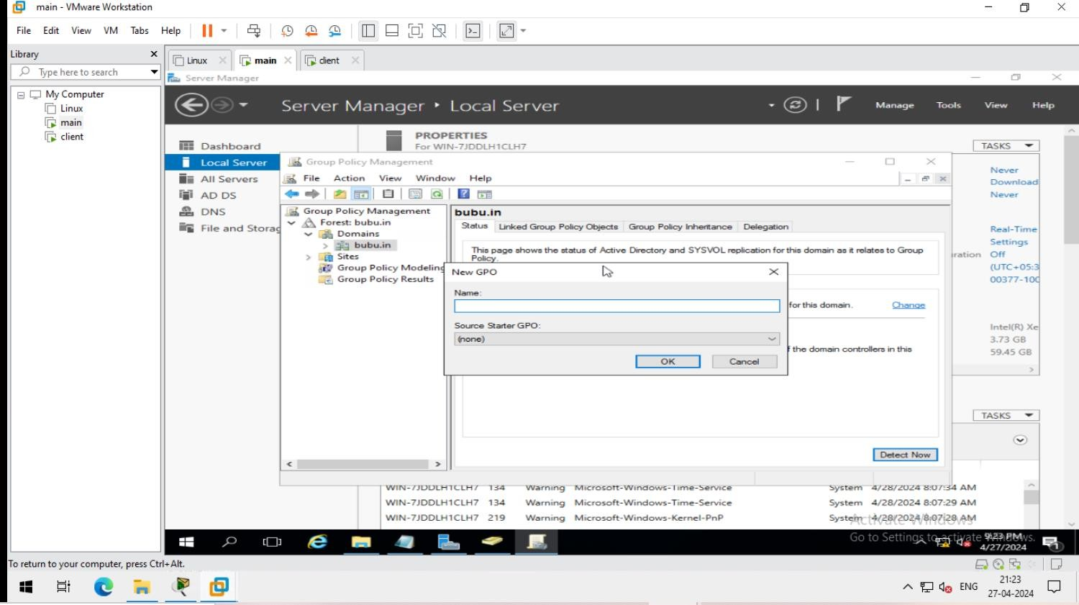
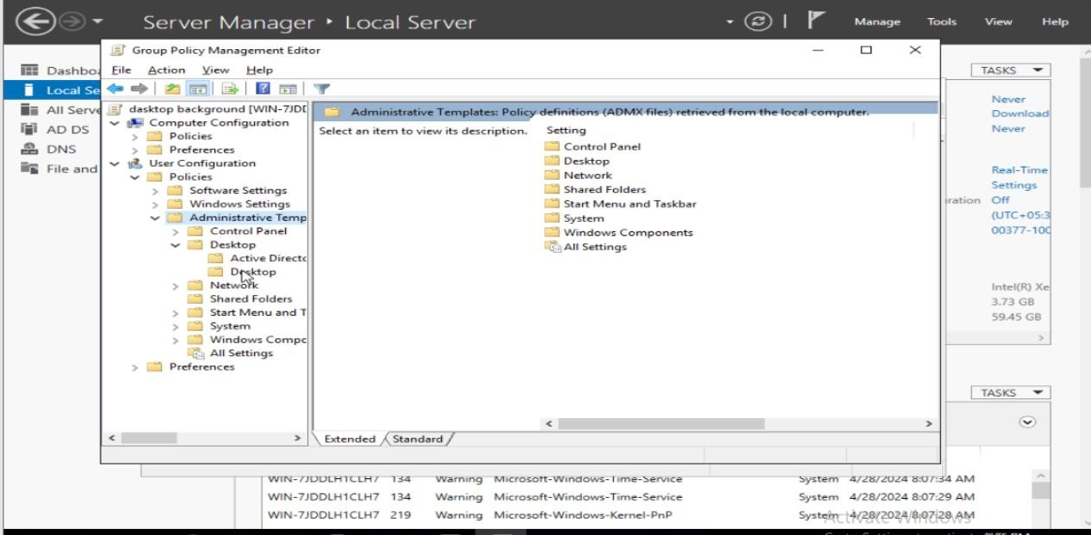
3.
4.

Slide 3
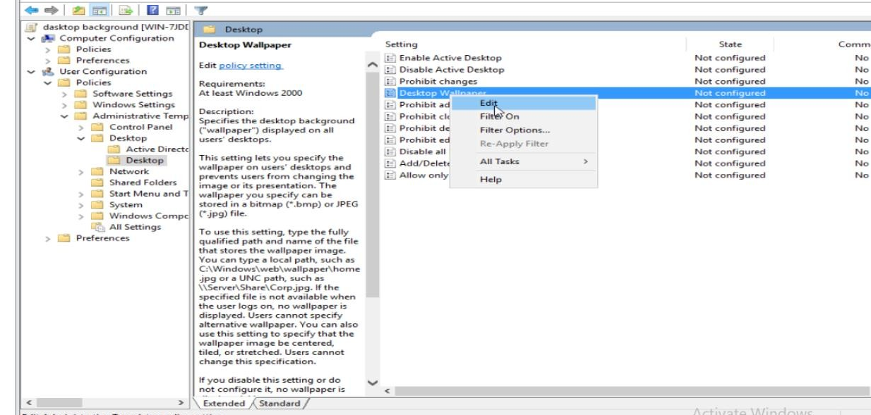
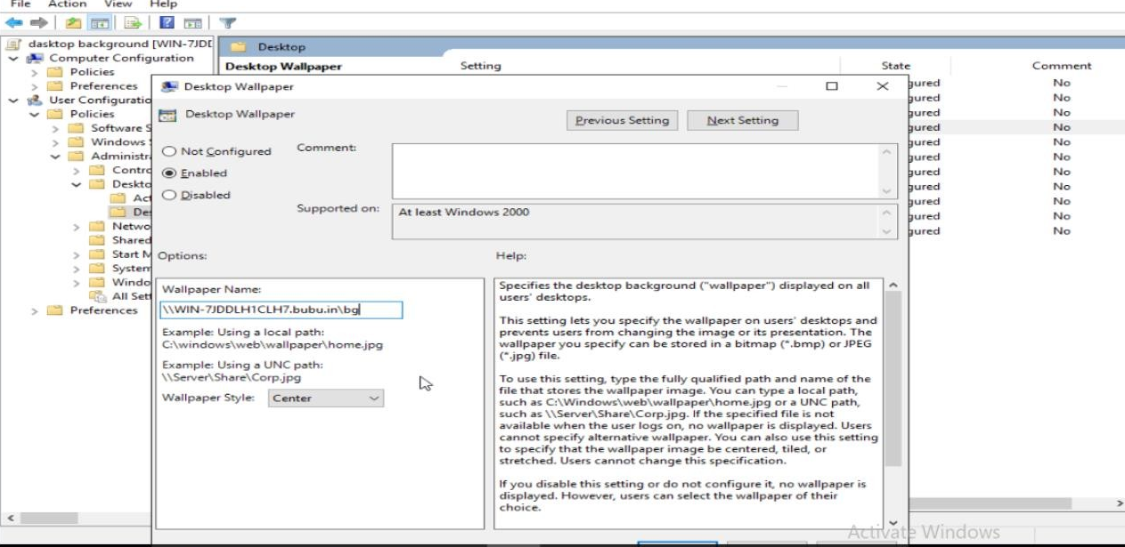
5.
6.

Slide 4
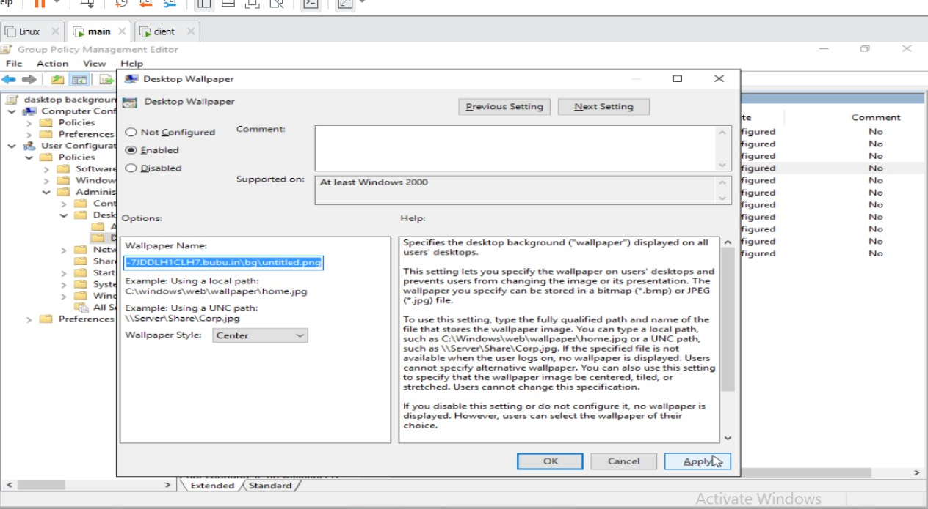
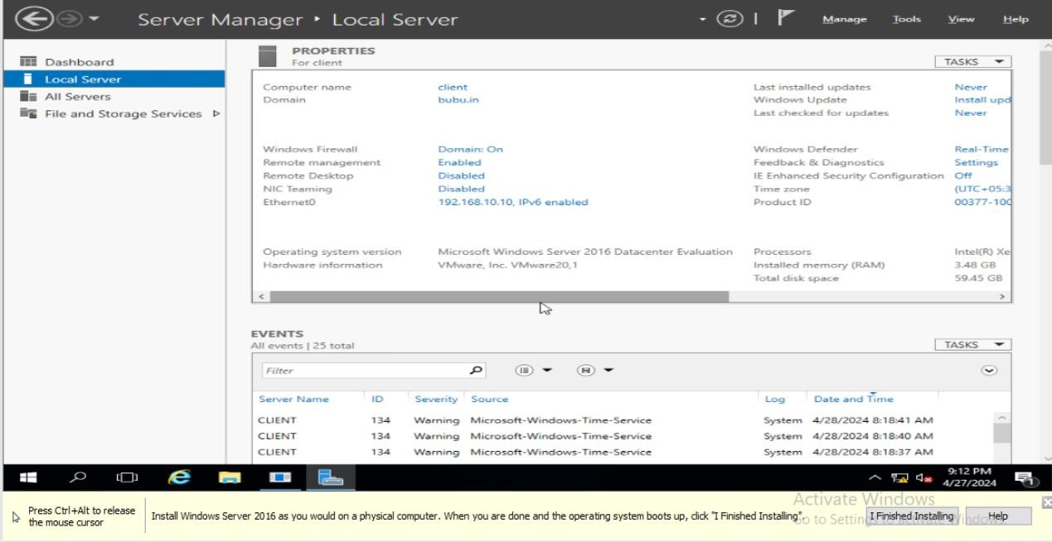
7.
GO TO THE CLIENT MACHINE FOR VERIFY
8.

Slide 5
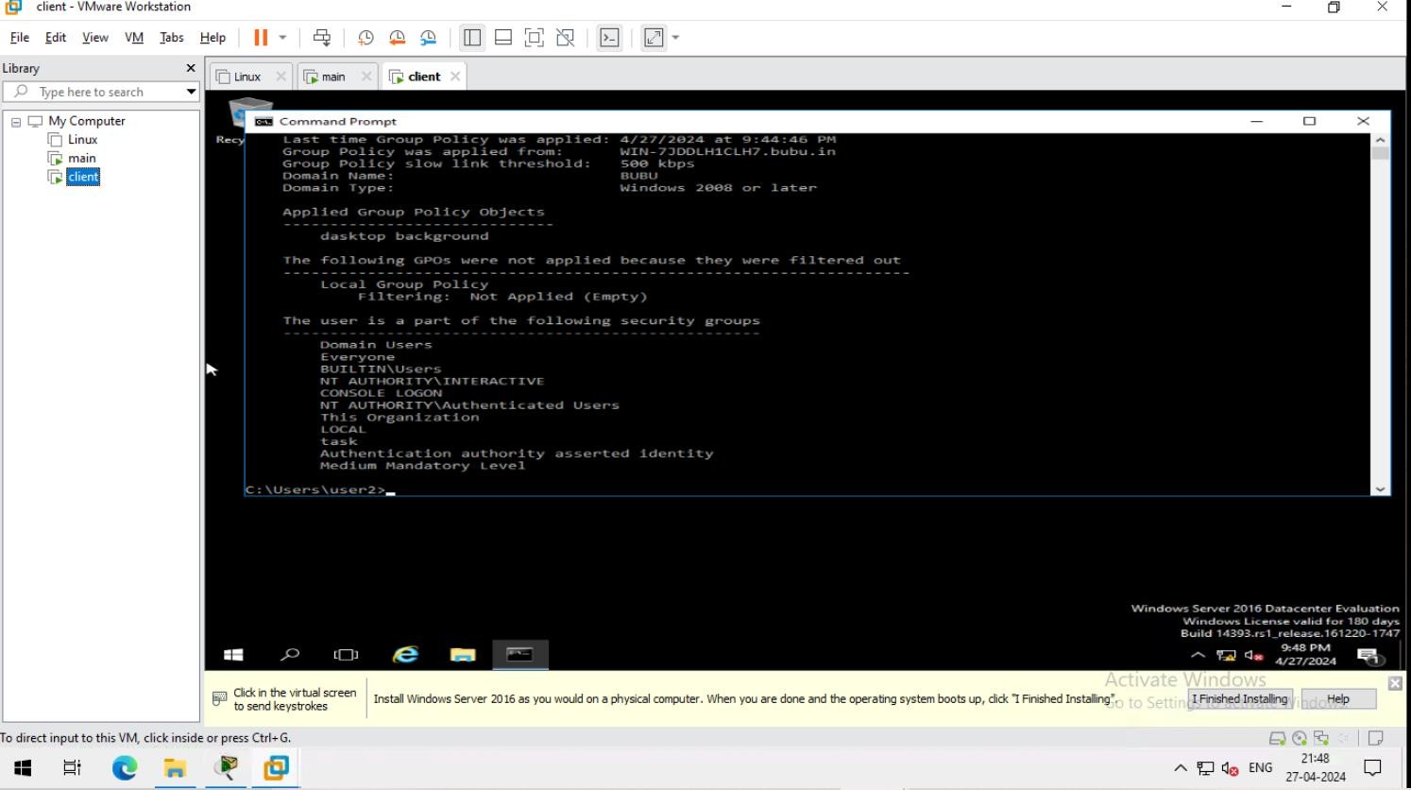
GO TO CMD AND VERIFY
9.

